Slide 1
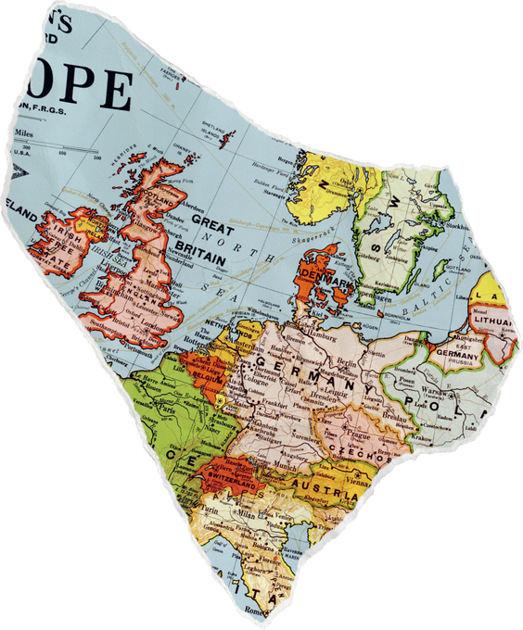
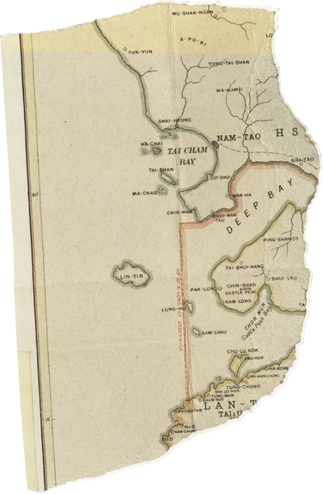


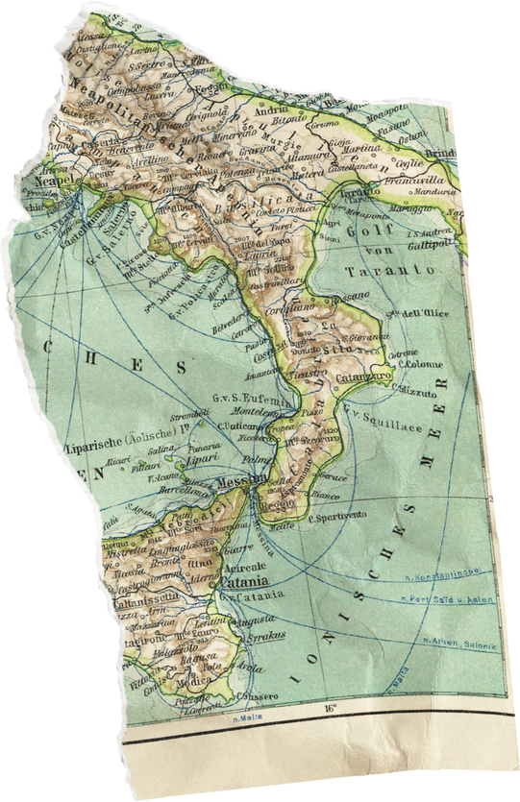
Smart Travel Recommender
Discovering unexplored corners
2SD22CS007 - Aishwarya Sheksindi
2SD22CS011 - Ananya Prabhu
2SD22CS012 - Ananya Gaonkar
2SD22CS015 - Anusha Hegde

Slide 2


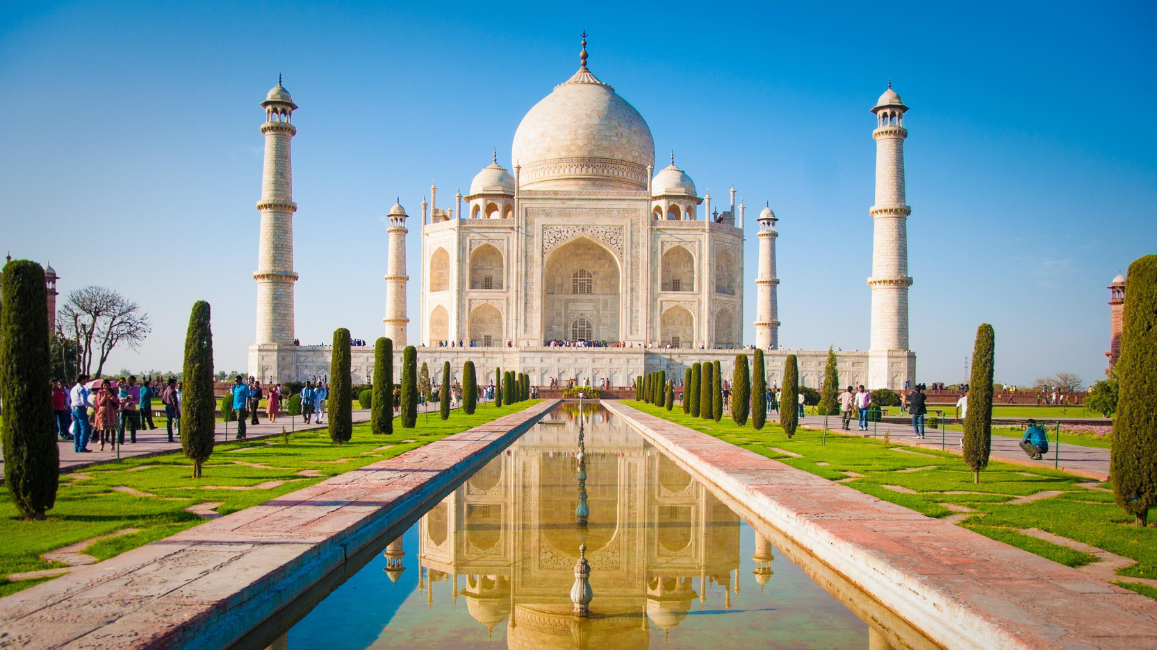
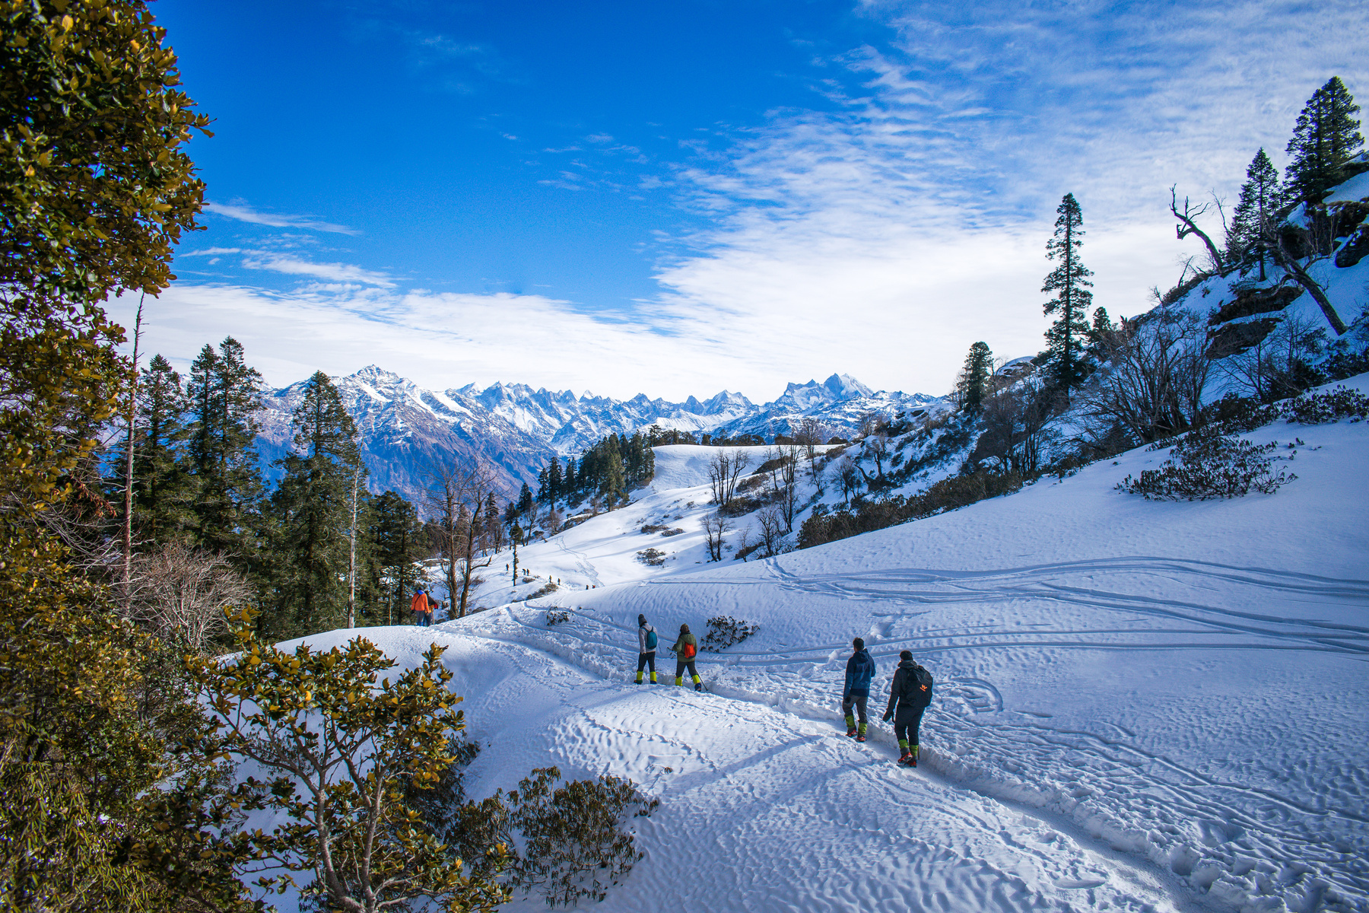

Introduction
A tourism recommendation system provides personalized suggestions for travel destinations, restaurants and accommodations, enhancing travelers overall experience.
It uses data-driven insights to recommend locations and attractions based on user preferences, helping tourists discover hidden gems tailored to their interests.

Slide 3
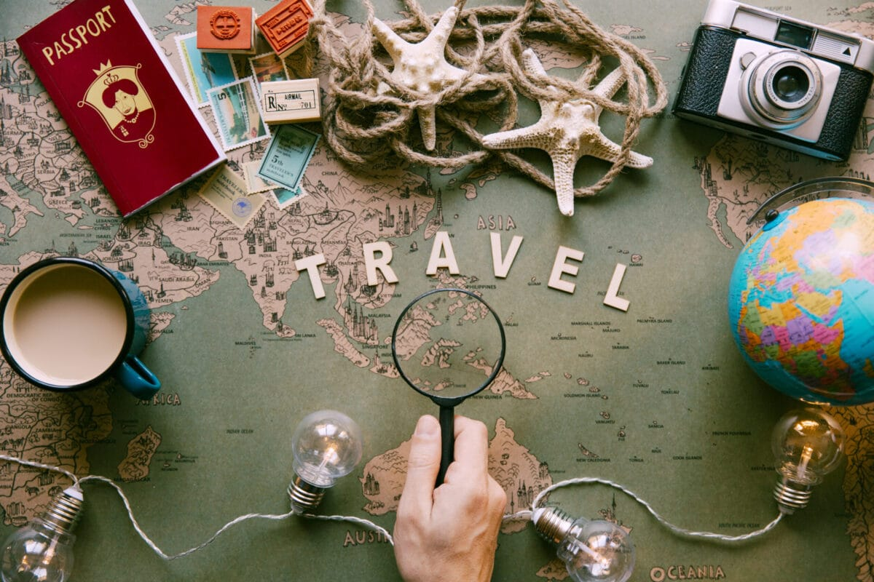
Objectives
Recommending tourist places, restaurants, and accommodations based on user preferences using a Collaborative filtering algorithm.
Gather and analyze data from various sources to enhance the system's accuracy.
User-friendly interface that makes it easy for users to input preferences and receive suggestions.

Slide 4
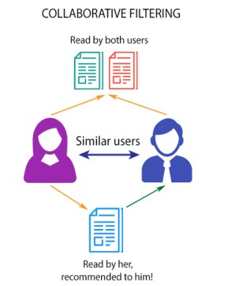
Methodology
Collaborative Filtering :
It is a recommender system that suggests items to users based on how other users with similar tastes and preferences have interacted with those items.
Types of Collaborative Filtering
User-based
Item-based

Slide 5
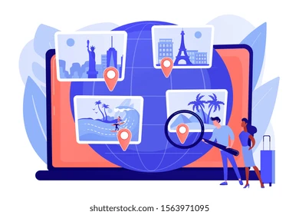
Expected Outcomes
Recommends tourist destinations based on users preferences, budget, and interest.
The system will reduce users’ time planning trips by offering quick, relevant suggestions.
Updates on availability, prices and local tourist places.
Suggestions for accommodations, and dining making it a comprehensive trip planner.

Slide 6
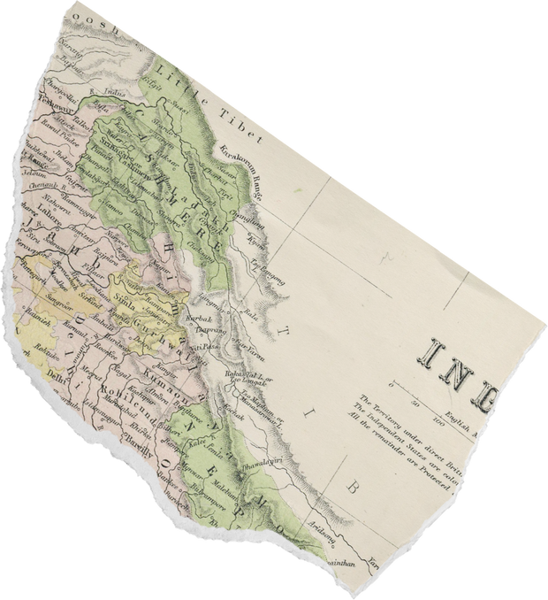
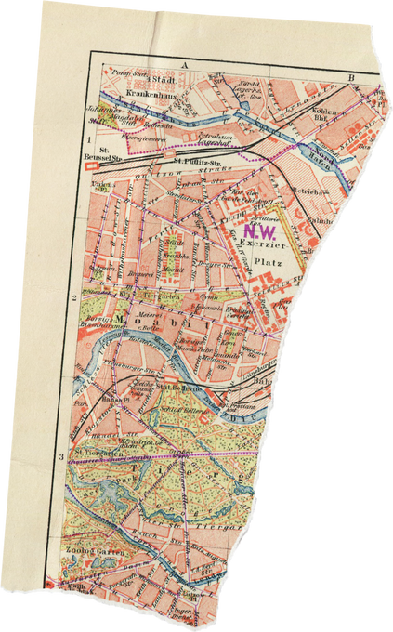
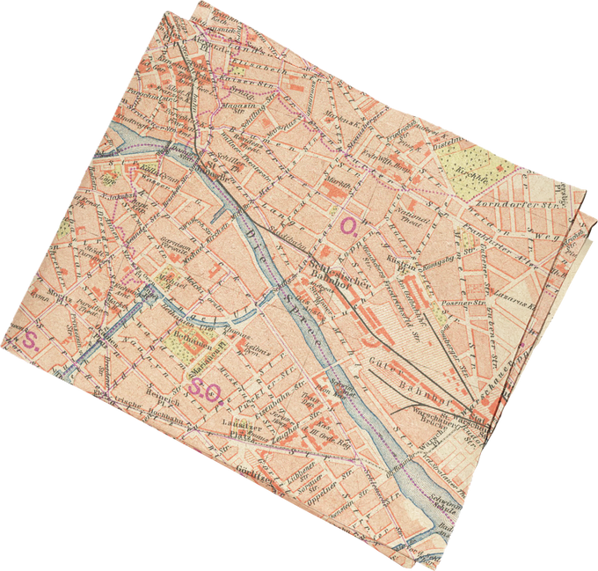
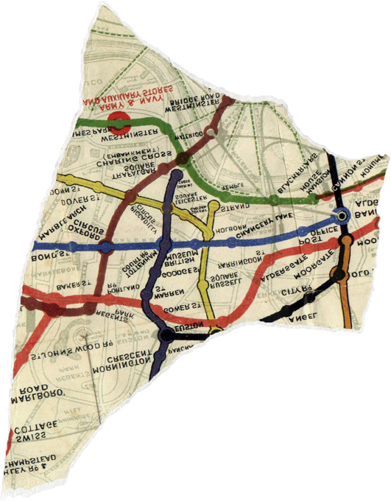
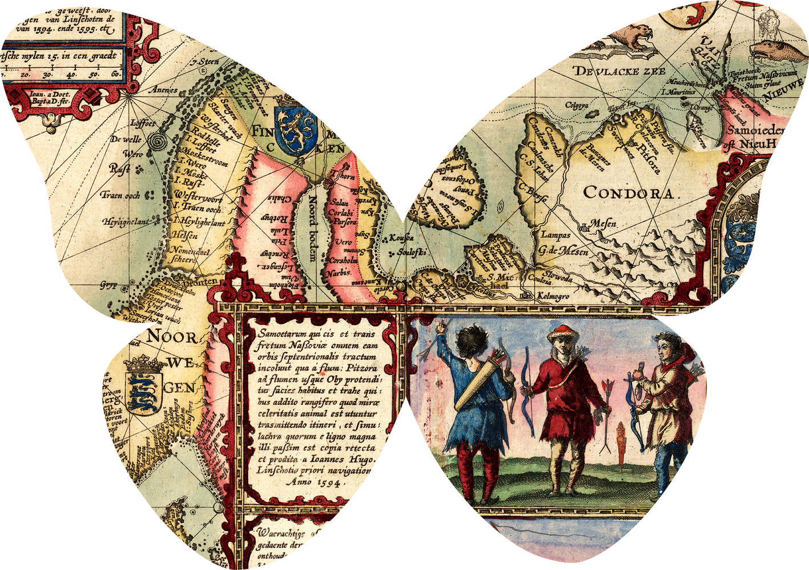
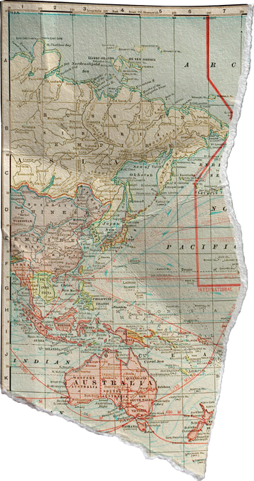
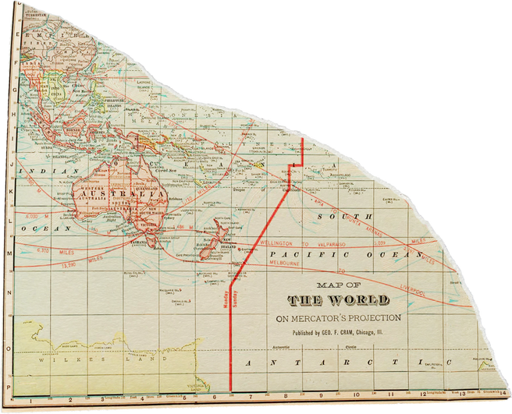
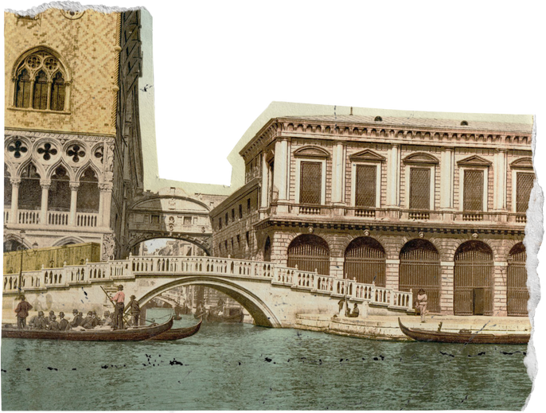
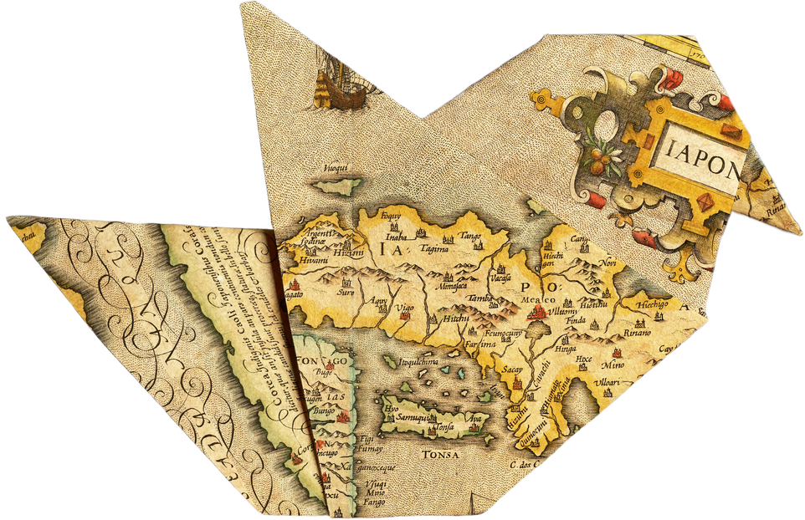
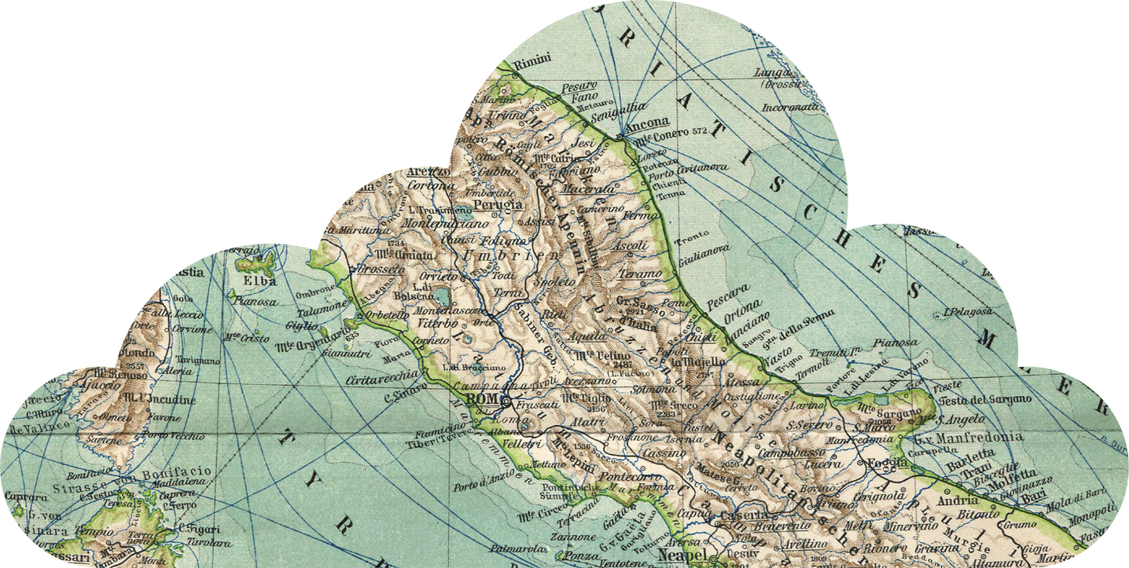
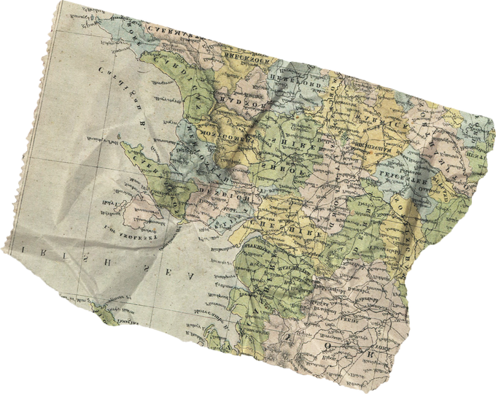
Thank you for visiting!

